Slide 1
BUNKER PRICE BENCHMARKING
SPEECH AT St. Petersburg
2019-06-27

Slide 2
Bunker Price Benchmarking: principles, algorithms – their dependence on the world oil market

Slide 3
Bunker Price Benchmarking
Where is the oil market?
What is it made of?
Where are all the prices coming from?
Oil Exchanges
Oil Future contracts
Oil Future price differentials

Slide 4
Physical Market
The physical market consists of a number of Suppliers’ estimate.
The estimation is mainly based on local environment.
Such as :
avails
barge allocations
local competition
weather conditions
oil future variations, to some extent

Slide 5
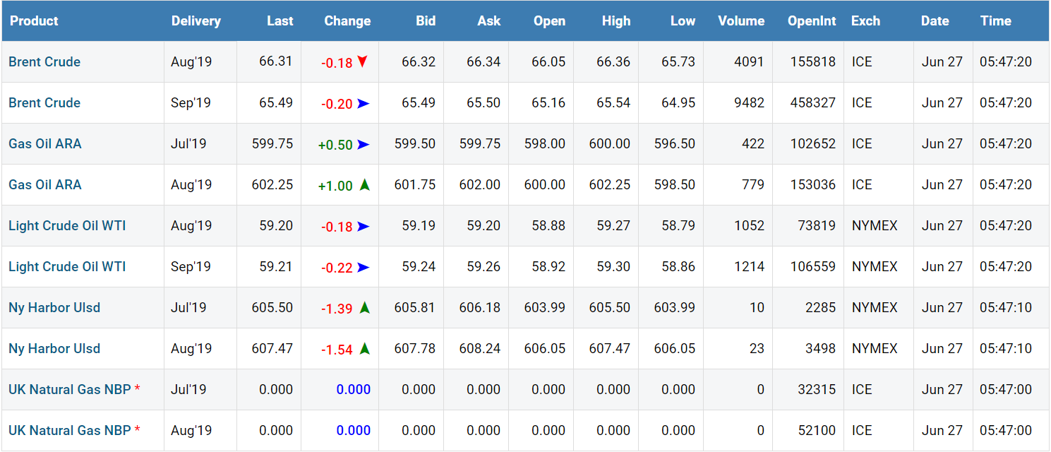
OIL FUTURE TABLE

Slide 6
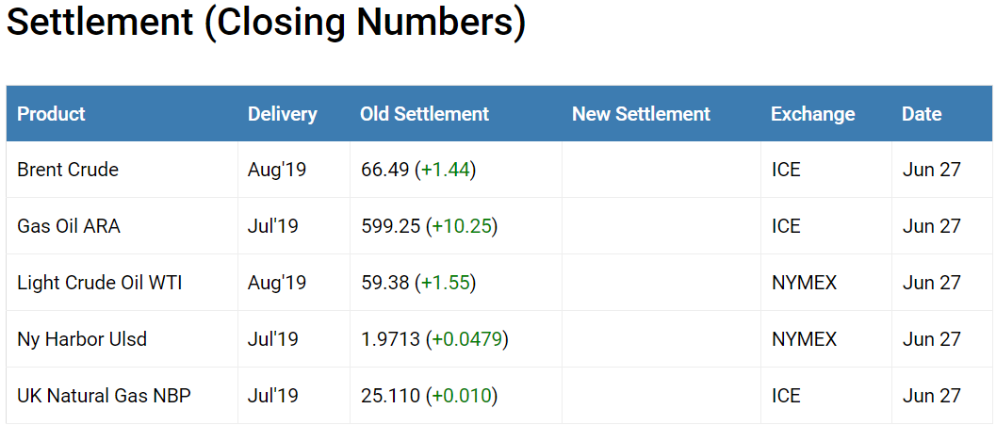
OIL FUTURE SETTLEMENT

Slide 7
Parallel Market
There is a parallel bunker market which we call:
OIL-FUTURE-CONNECT MARKET
OIL-FUTURE-CONNECT MARKET relates entirely to Oil Future differentials - giving
Oil-Future-Connect Prices (OFC).

Slide 8
Two markets of bunker prices competing with each other:
Physical Market Prices
Oil-Future-Connect prices (OFC).

Slide 9
Today priority is given to the physical local prices,
but
perhaps glancing at
the Oil Future Market.

Slide 10
MABUX suggests another solution:
HOW?

Slide 11
MABUX suggests another solution:
Firstly: Oil-Future-Connect prices (OFCP) should be the base for physical bunker prices.
The New Benchmark
Secondly: Physical local prices to be given a chance to influence the OFCP, (if needed?)

Slide 12
BECAUSE:
Oil Future Connect prices (OFCP) are created from a much broader source of information + completely independent.

Slide 13
How does it work?
1.Everything starts with the bunker market’s physical price in each port. We establish a “fair market price” in each port.
2. A “fair price” average to be calculated for a fixed period. (ex. 1 month)
3. Secondly, calculate an average price for the Oil Future crude oil, Brent or WTI. Type of crude oil depends on the geographical location of the port, and period to be the same as for the calculated “fair price”.
Dividend = fair price average
Devisor = crude oil price average
Result = multiplier

Slide 14
Crude Oil conversion to Fuel Oil 380HS
 | Market Indication | Brent ”chg” | Multiplier | Diff in USD/mton | OFCp
Day 0 | 305 | - 0.51 | x 5.3 | - 2.7 | 305
Day 1 | 303 | + 0.8 | x 5.3 | + 4.24 | 302.3
Day 2 | 308 | + 0.55 | x 5.3 | + 2.91 | 306.54
Day 3 | 312 | - 0.44 | x 5.3 | - 2.33 | 309.45
Day 4 | 309 | - 0.61 | x 5.3 | - 3.23 | 307.12
Day 5 | 304 |  |  |  | 303.89
305
305
302
302
307
307
309
309
307
307
304
304
Conversion Brent Crude Oil Fuel Oil 380HS
Market Indication USD/mton Brent closing USD/barrel
= Multiplier = 5.3

Slide 15
Marine Gas Oil (MGO) vs Oil Future Gas Oil
 | Market Indication | Oil Future Gas Oil close | Diff in USD/mton | OFCp
Day 0 | 475 | 452 | + 10 | 475
Day 1 | 487 | 459 | + 7 | 485
Day 2 | 490 | 457 | - 2 | 492
Day 3 | 489 | 469 | + 12 | 490
Day 4 | 499 | 450 | 19 | 502
Day 5 | 489 |  |  | 483
475
485
492
490
502
483

Slide 16
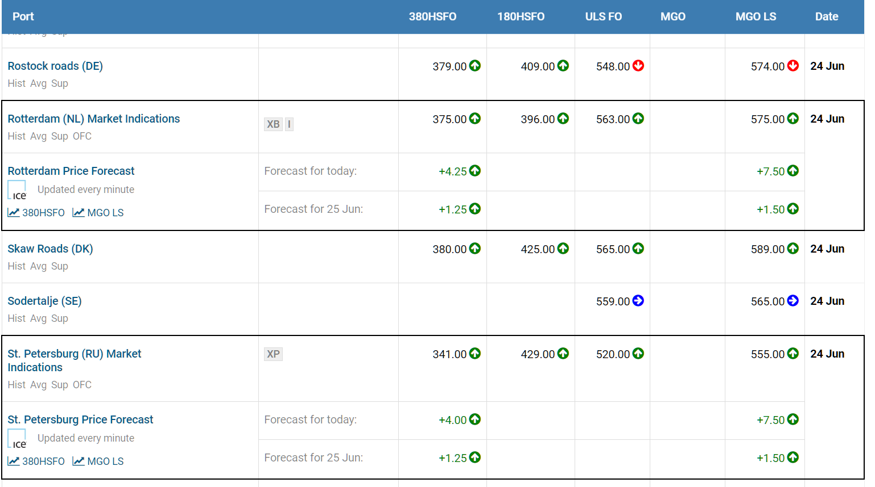
Spot Bunker Market: North Europe

Slide 17
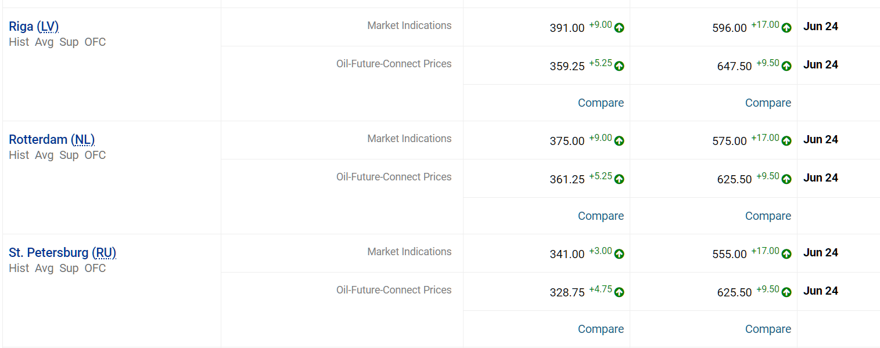
Physical/Parallel (OFC) Prices

Slide 18
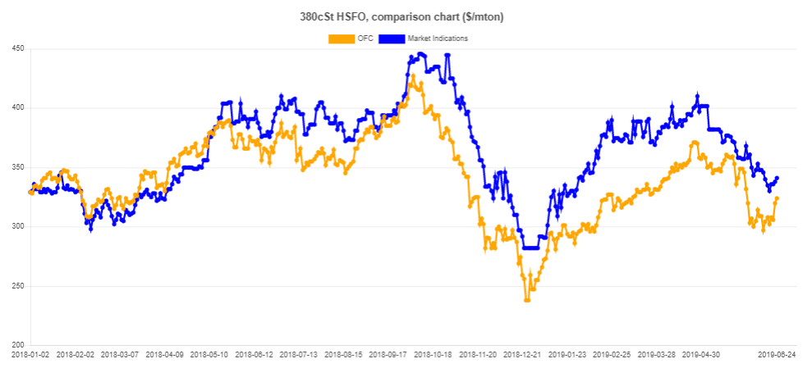
St. Petersburg Physical/OFC curves
1,5 year,
380 HSFO
Starting date : 2018-01-02.

Slide 19
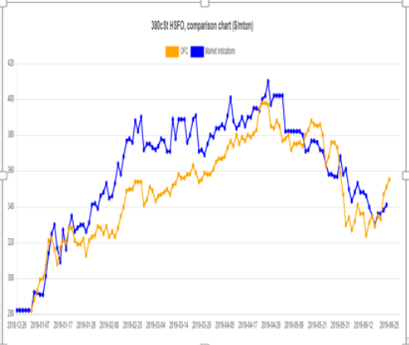
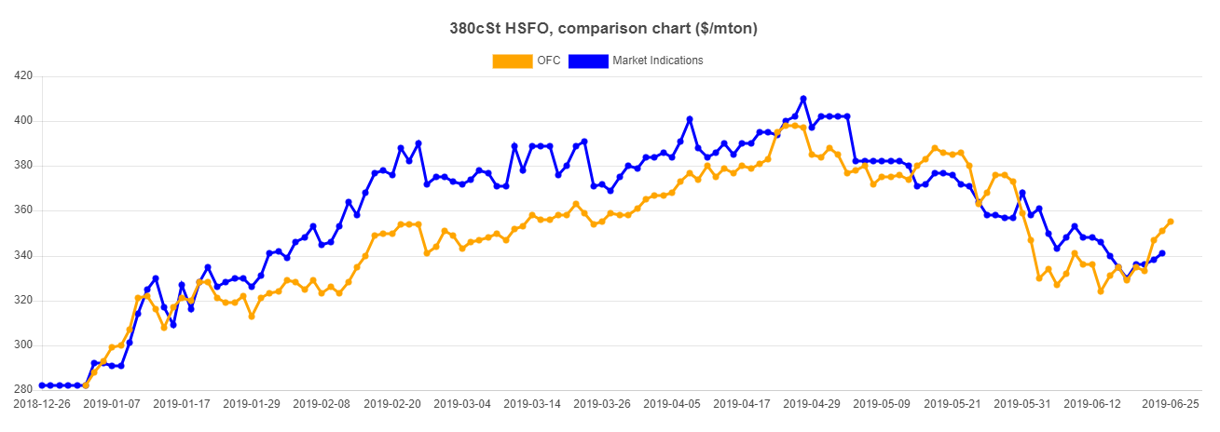
St. Petersburg Physical/OFC curves 6 months +, 380 HSFO
Starting date of the last set: 2019-01-02

Slide 20
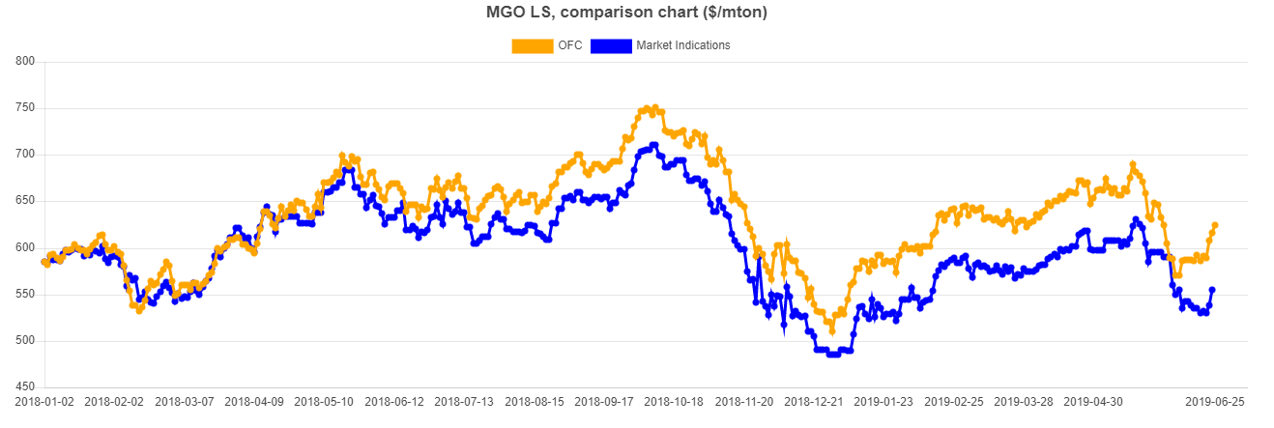
St. Petersburg Physical/OFC curves 1 year +, MGO
Starting date of the last set: 2018-01-02

Slide 21
Rio de Janeiro physical/OFC price curves 1 year +, 380 HSFO
MGO
Starting date of the last set: 2018-01-02

Slide 22
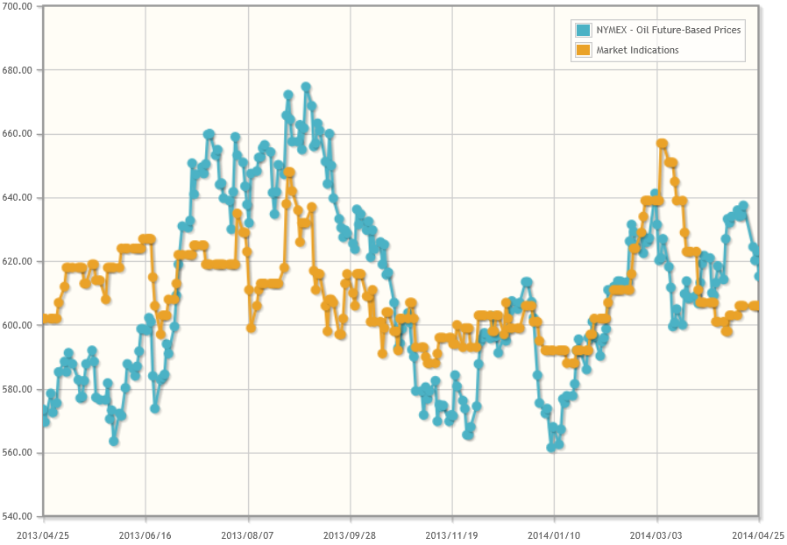
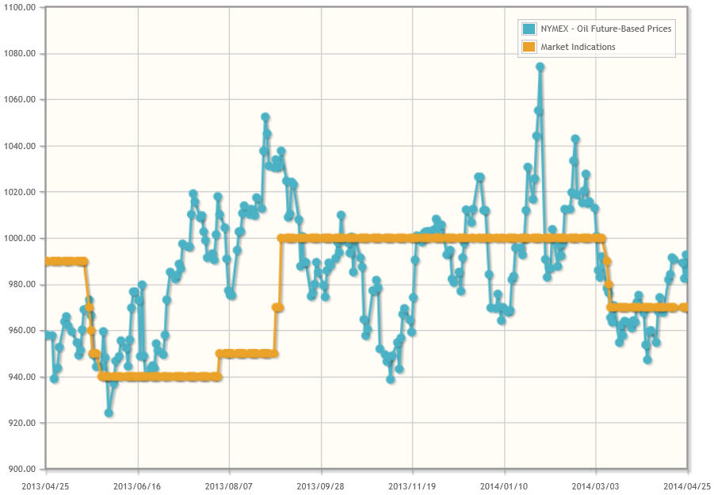
Rio de Janerio Market Indications vs Oil-Future-Based Prices
2013-04-25 – 2014-04-25
380 HSFO
Gas Oil

Slide 23
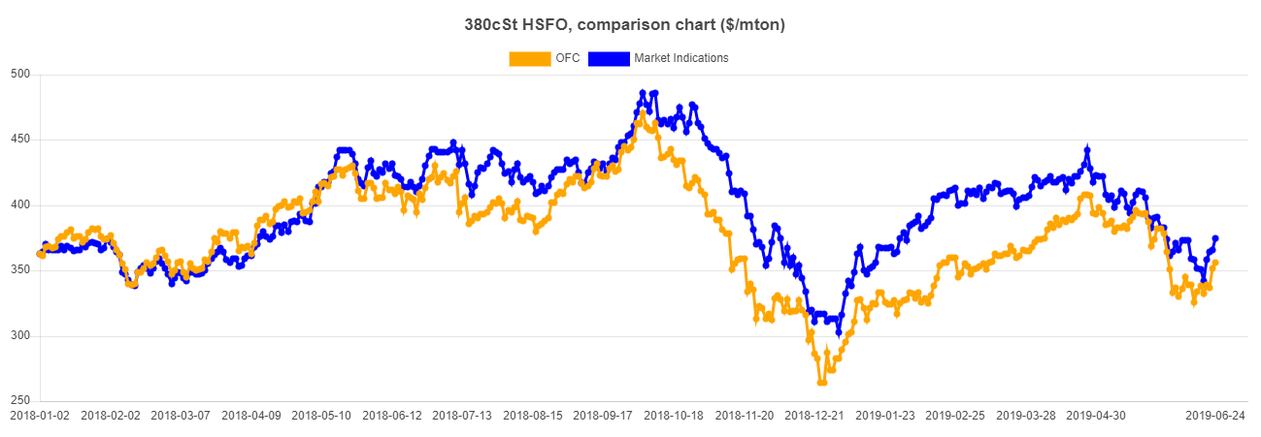
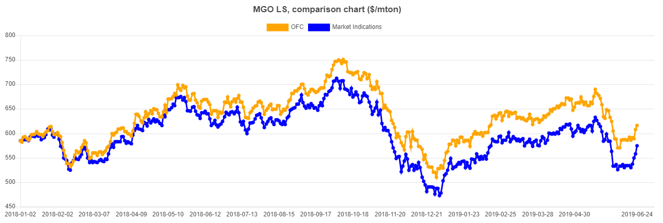
Rotterdam Physical/OFC curves
380 HSFO
1,5 year
MGO LS
Starting date of the last set: 2018-01-02

Slide 24
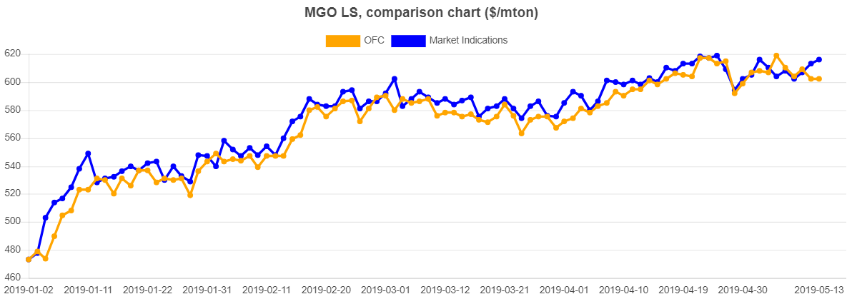
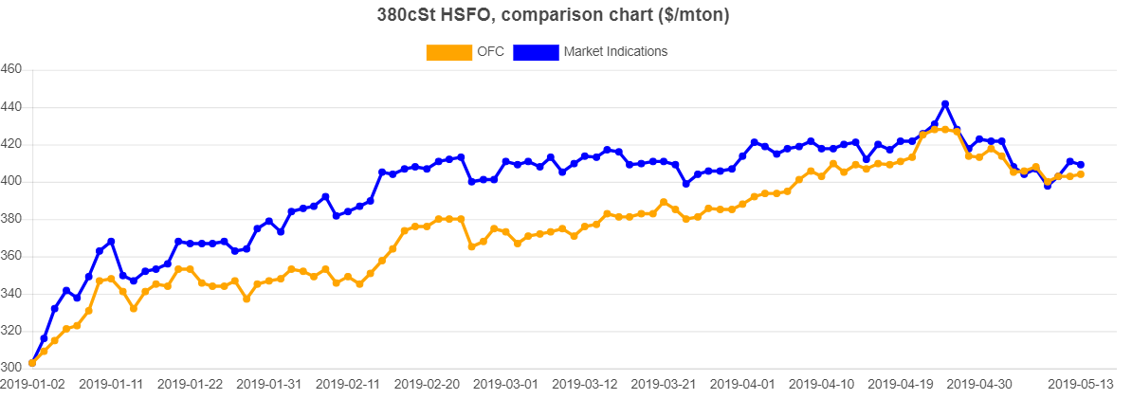
Rotterdam physical/OFC price curves 4 months +, 380 HSFO
MGO LS
380 HSFO
Starting date of the last set: 2019-01-02

Slide 25
Valparaiso physical/OFC price curves 1 year +, 380 HSFO
MGO
Starting date of the last set: 2018-01-02

Slide 26
Rotterdam physical/OFC curves 2 months, 380 HSFO
OVERCHARGED

Slide 27
Rotterdam physical/OFC curves 2 months, MGO
UNDERCHARGED

Slide 28
Rotterdam physical/OFC (Benchmark) prices comparison table
Benchmark
Benchmark
Benchmark

Slide 29
OUR ADVICE IS TO USE OFCP AS A NEW BENCHMARK

Slide 30
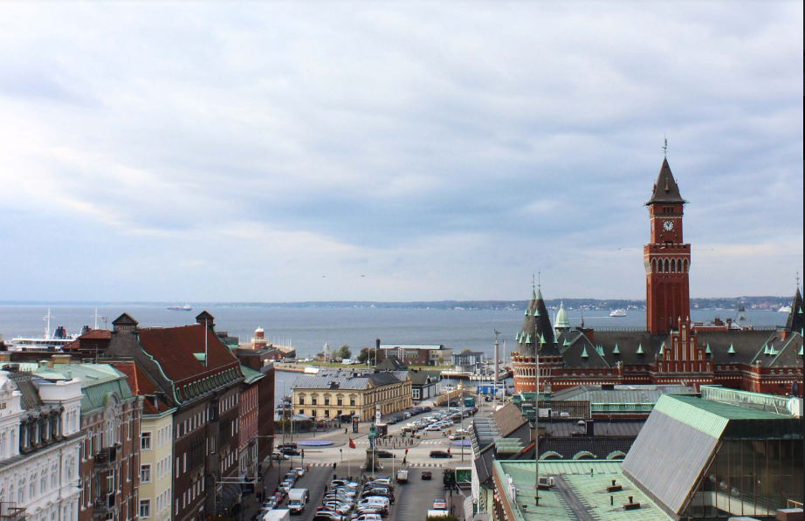
CARL-JOHAN GARSTEN
MANAGING DIRECTOR
Marine Bunker Exchange (MABUX) AB
Kullagatan 6, SE-25220,
Helsingborg,
Sweden
Tel: +46 42 140430
Mob. +46 709409454
E-mail: info@mabux.com
Website: www.mabux.com
Website: www.mabux.ru

