Slide 1

COORPERATION WITH NORWEGIAN MARITIME INDUSTRY
Design
Equipment
Construction
Export Financing
St.Petersburg 22.06.2018
CEO Rolf Fiskerstrand
FISKERSTRAND HOLDING AS

Slide 2
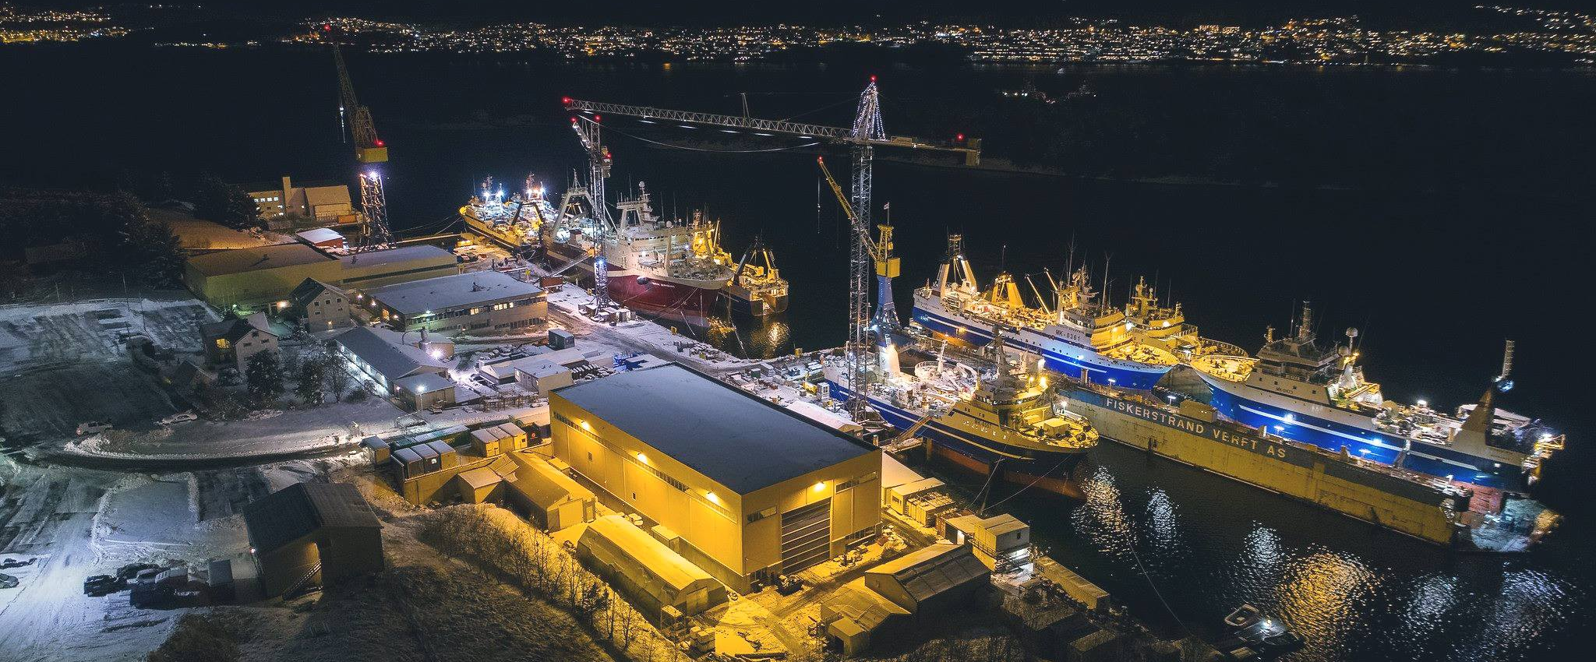
DESIGN - DOCKING - CONVERSION - REPAIR - MAINTENANCE - SHIPBUILDING
Fiskerstrand Holding AS
Fiskerstrand Verft AS
Fiskerstrand Eiendom AS
Multi Maritime AS
FISKERSTRAND HOLDING AS

Slide 3

IN THE RUSSIAN MARKET SINCE 1999
Working with Russian Shipowners for 18 years
Docking, repair, maintenance and conversion
27 ships at the yard in 2017 and 17 ships already booked for 2018
Russian speaking employees at our company
Excellent cooperation with our Russian customers
Harbour base for service, storage, logistic and support for Russian fishing fleet

Slide 4
  FROM IMPORT / EXPORT TO CLOSE BUSINESS COOPERATION?
The aim should be to find a common platform in order to create business together, share competence, perform projects together and earn money for the partners
Must establish a «road map» in order to secure stability and predictability both ways
Norwegian companies might find partners in Russia and eventually invest in Russia
Must be secured by relevant jurisdiction
Norway assisting on maritime technology together with Russia on R&D, consepts, design and building of new ships. Can also be strong together in development of new market segments

Slide 5
OVERALL OBJECTIVE
NEWBUILDING
Define a work process identifying responsibilities, milestones, sourcing and teams who shall govern design, rules & regulations, detail engineering and construction
BENEFITS
Clearly defined responsibilities, i.e. shorter and direct lines.
Increased performance, mitigate risk for mistakes and errors in technical drawings by a defined working processes.
Higher level of commitments
Less rework at hullyard and during final construction
  Increased delivery performance and reliability
  Costsavings, less rework at outfitting yard simplifies own production planning.
Design
Owner
Yard

Slide 6
LIFECYCLE
NEWBUILDING
Concept development
Design/technical review
Suppliers compliance
Contract Signing
Purchase
Construction / outfitting
Delivery
Warranty
Aftermarket
Spareparts
Conversion
Maintenence
A newbuilding can be defined in several phases, each linked with individual processes.

Slide 7
WORK FLOW – CONCEPT AND BIDDING
NEWBUILDING
IMO and Class
Tender
Design and Building specification
OWNER
CONCEPT
OFFER AND
CONTRACT
YARD
OWNER
Vendor Subcontractor
Hull
Yard

Slide 8
RESPONSIBILITY MATRIX
NEWBUILDING
  Bid/Sales/Contract
  Contract responsibility
  P&L responsibility
  Detail Engineering
  (if agreed)
  Purchase
  Construction
  Commissioning
  Concept
  Design
  Outline drawings
  Production drawings
  Class and authorities approval
YARD
DESIGNER
CLASS/
Authorities
HULL YARD
  Approval
  Inspection
  Steel production
  Installation of supplied equipment and pipes above 50 mm
  Painting

Slide 9
WORK FLOW – PROJECT EXECUTION
Class
Design
Class
Design
Class
DESIGN
DESIGN TO COMPLETE
YARD
DESIGN TO PRODUCTION
YARD
YARD
OWNER
HULL YARD
Owner
Hull
YARD
SUPPLIER
Hull
YARD
SUPPLIER
OWNER
SUPPLIER

Slide 10
WORK FLOW – PROJECT EXECUTION
NEWBUILDING
OWNER
SALES
PROJECT MANAGEMENT
CONTRACT
PLANNING
TECHNICAL
PRODUCTION
DELIVERY
PROJECT
ALLOCATION
PURCHASE
COMMISSIONING
HARBOUR TEST
SEA TRIALS
Certificates
Delivery protocols
Test documents
Project Manager
Resources
Finance
OWNER
CLASS
HULL
SUPPLIERS
DESIGNER
Hull
Purchase
Purchase project
Technical
Engineering
Production
Purchase stock
Cashflow
Purchase
Planner
KICK OFF
DETAIL ENGINEERING
OUTFITTING / TESTING
HANDOVER
Contract Signing
Planning
Technical
Purchase
Production
Testing
Delivery
After-
market
Stakeholders
  Sales Contract review, CFO, CTO, COO, Project Group (Project Management, Purchase, planner)
  Planning Detail planning, resources and milestones CFO, CTO, COO, Project Group (Project Management, Purchase)
  Technical Mapping suppliers, Project Management, CTO, EtO
  Purchase Purchase to order, deliverables Project Management, EtO
  Production Production planning, outfitting System Specialist, Project Management, Commercial

Slide 11
Financing of ship, “part of ships” or retrofit from Norwegian exporter
EKSPORTKREDITT
Norwegian exporter
Contract for the
delivery
Loan agreement
Export Credit Norway
Russian buyer/owner
Credit
Insurance
(60-90%)
Payment guarantee
(10-40%)
Guarantee agreement
GIEK/ECAs
Bank

Slide 12
Three types of financing within the Maritime industry
EKSPORTKREDITT
Ship
«Parts of Ships»
Retrofit
  Ships built in Norway for
    Foreign owner
    Norwegian owner within the offshore sector
  Ships built at Norwegian owned yard outside Norway
    Shipyard in Country A Owner/buyer in Country B
  Export Credit Norway can finance up to 80% of the shipbuilding contract
  For ships to be built by yards outside Norway
  Repayment period – up to 12 years
  Export Credit Norway can finance up to 80% of the contract amount of Norwegian Ship equipment and Services
  Retrofit equipment is defined as capital goods considered as depreciable capital equipment
  Repayment up to 8 ½ years.
  Minimum 30% Norwegian content.
  Export Credit Norway can finance up to 85% of the retrofit contract
  Credit Frame Agreement

Slide 13
EKSPORTKREDITT
PRE-CONTRACT CIRR RATES 15.05.2018 - 14.06.2018 Fixed rates for the period in % p.a.
 | < 5 y | 5.5 – 8.5 y | 9-12 y
NOK | 2.67 % | 2.67 % | 2.67 %
USD | 3.72 % | 3.90 % | 4.02 %
EUR | 0.79 % | 1.15 % | 1.47 %
Attractive interest rate option:
The CIRR rate

Slide 14
THANK YOU FOR YOUR ATTENTION!
22.06.2018
CEO Rolf Fiskerstrand
FISKERSTRAND HOLDING AS

